Slide 1
Design and Verification of 4-Function ALU using Logic Gates
Coa | bsc cs | fy
1400. Krishna Kamlesh singh

Slide 2


What is an ALU?
The ALU is the computational core of a CPU, executing arithmetic and logical operations on binary data. It forms the foundation of processor architecture and computer system functionality.
Processes instructions by performing calculations, comparisons, and data manipulations essential for program execution and system operations.

Slide 3

Project Objectives
Design Architecture
Logic Gate Implementation
Develop a 4-function ALU capable of executing addition, subtraction, AND, and OR operations on binary inputs
Construct the circuit using fundamental logic gates: AND, OR, NOT, XOR, and Full Adder components

Slide 4
Project Objectives
Logisim Simulation
Output Verification
Build and test the complete circuit in Logisim digital design software with proper input/output configurations
Validate functionality through comprehensive truth table analysis and multiple test case scenarios

Slide 5
Components and Building Blocks
LOGIC GATES
AND, OR, NOT, XOR gates for Boolean operations
FULL ADDER
Handles binary addition with carry propagation
MULTIPLEXER
Selects between multiple operation outputs
Input switches and LED displays for testing
I/O DEVICES

Slide 6
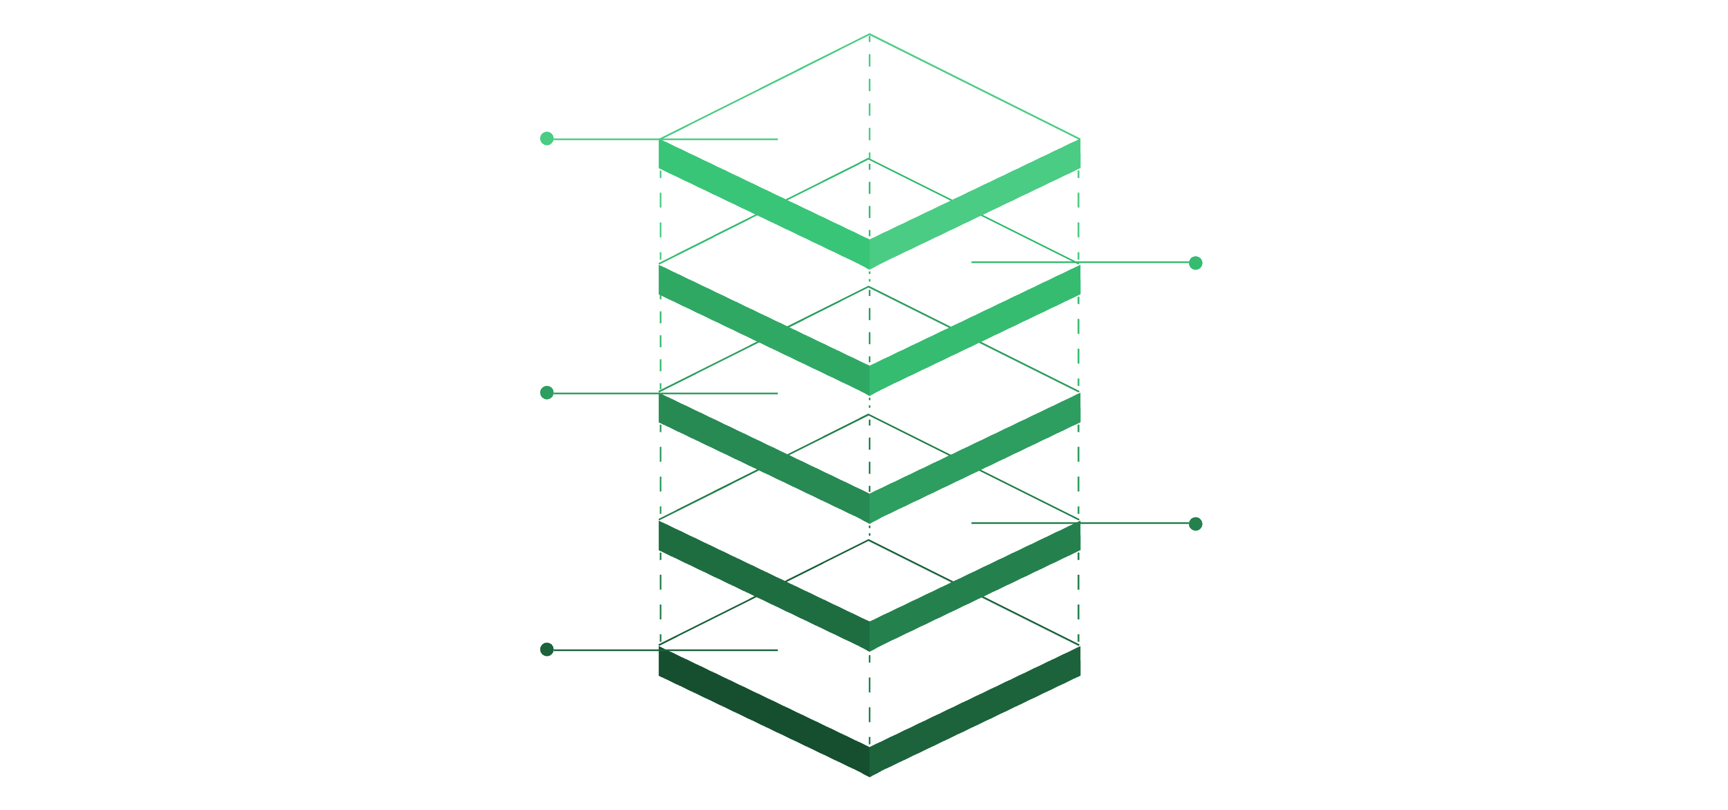
ALU Block Diagram
Outputs
Result(4) and Cout
Input Signals
Two 4-bit binary inputs (A, B)
Carry input (Cin)
Two operation select lines (S0, S1)
Multiplexer
Selects final outputs based on S lines
ALU Core
Per-bit arithmetic and logic units
Output Signals
4-bit result output
Carry output (Cout)
Operation selection control
Operation Select
S0 and S1 control ALU mode
Inputs
A(4), B(4), Cin

Slide 7
Four Operations Implemented
00
01
Addition (A + B)
Subtraction (A - B)
Binary addition using Full Adder circuits with carry propagation through all bit positions
Two's complement subtraction implemented using addition with inverted subtrahend
10
11
AND Operation
OR Operation
Bitwise logical AND between corresponding bits of inputs A and B
Bitwise logical OR between corresponding bits of inputs A and B

Slide 8
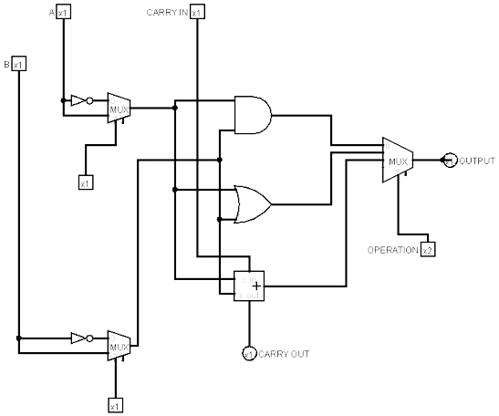
Circuit Design and Operation
Implementation Details
The ALU was constructed in Logisim using discrete logic gates connected through a multiplexer-based selection system.
Control Mechanism
Selection lines S0 and S1 determine the active operation. The multiplexer routes the appropriate operation result to the output based on these control signals.
Carry Logic
Carry propagation implemented through Full Adder circuits, with carry-out from one bit feeding carry-in to the next higher bit position.

Slide 9
Truth Table Verification
Operation selection and expected outputs for all four functions:-
S1 | S0 | OPERATION | OUTPUT
0 | 0 | ADDITION | A+B
0 | 1 | SUBTRACTION | A-B
1 | 0 | AND | A ∧ B
1 | 1 | OR | A ∨ B
Each operation verified with multiple input combinations to ensure correct functionality across all bit positions.

Slide 10
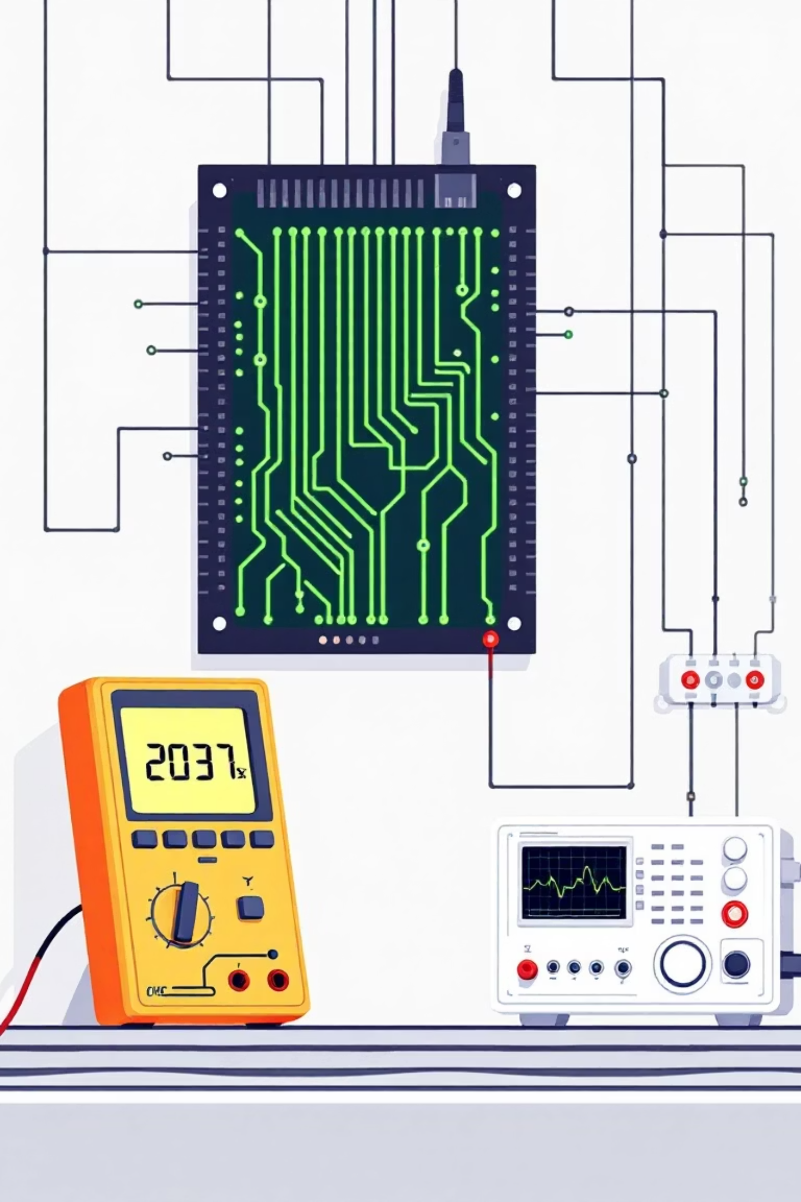

Testing and Verification Methodology
Individual Gate Testing
Verified functionality of each logic gate and Full Adder circuit independently before integration
Operation Mode Testing
Tested each operation (addition, subtraction, AND, OR) with various input combinations to validate correctness
Edge Case Analysis
Examined overflow conditions, negative results, and boundary values to ensure robust operation
Truth Table Validation
Compared simulated outputs against theoretical truth table predictions for comprehensive verification

Slide 11
Conclusion and Future Scope
Project Success
Successfully designed and implemented a 4-function ALU using fundamental logic gates with complete operational verification through simulation
Key Learning Outcomes
Enhanced understanding of digital logic design principles, circuit construction techniques, and simulation methodologies using industry-standard tools
Future Enhancements
Expand to 8-bit or 16-bit architecture, incorporate additional operations (XOR, shift), implement pipelining, or integrate with CPU control unit for complete processor simulation

Slide 12
THANK YOU
1400. Krishna Kamlesh Singh
BSc FYCS- C | COA | 2025-26 | MES-PCACS |

